Slide 1
MEU in a Nutshell
For Teachers with no MEU or MUN Experience

Slide 2
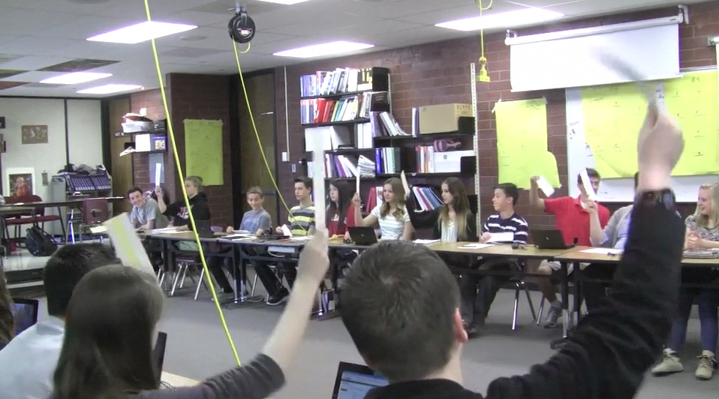
Key Components
28 Member States
Seating is unique
Parliamentary Procedure
Roll Call
Tour de Table
Notes:
Rules/Procedures oriented part of the session. Point out what role students play in the EU. 28 heads of government/ministers.

Slide 3
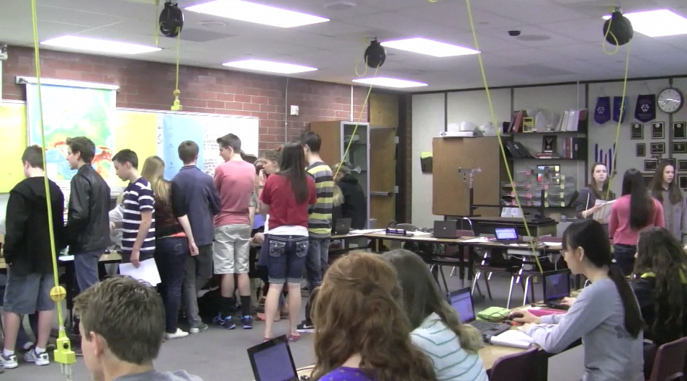
Key Components
Informal Debate
Formal Debate
Speaker’s List
Voting
Consensus
Notes:
Collaboration and debate/voting part of the session. Remember the importance of order throughout so all 28 member states can compromise.

Slide 4
MEU in Action
Look for how well the students follow the rules and procedures we just discussed.
Notes:
Remember, if 9th graders can do it- so can you. Pay attention to what the students say they learned from the experience and how it benefited them. Don’t you want the similar results in your classrooms?
(8 minute video)

Slide 5
Comments/Questions?
Notes:
Do teachers need a clarification at this point about the structure?

Slide 6
Online Resources
Competition Resources
Background Guides for the upcoming competition topic
Position Papers/Resolution guidelines
Teacher Trainings
Detailed Rules/Procedures
Detailed Background Guide and Resources
Student Trainings
Suggested research resources
Summary of rules and procedures
Background Guides
Also visit: mun.byu.edu
Diplomacy
Parliamentary Procedure
Public Speaking
Please Visit: meu.byu.edu (Secondary MEU Program)
Notes:
Rules/Procedures oriented part of the session. Point out what role students play in the EU. 28 heads of government/ministers.

Slide 7
Writing Templates
Position Paper
Resolution
Please Visit: meu.byu.edu (Secondary MEU Program)
Notes:
Helping teachers understand the difference. Remind them of deadlines- position papers are due before the competition and resolutions are made during the competition.

Slide 8
Competition Resources
Please Visit: meu.byu.edu (Secondary MEU Program)
Notes:
Most important information here is the Background Guide: Cohesion Policy is the November topic AND the position paper/resolution template

Slide 9
How to Prepare (Teachers)
Please Visit: meu.byu.edu (Secondary MEU Program)
Notes:
Focus on understanding the EU and its institutions so you can understand the structure/organization

Slide 10
How to Prepare (Students)
Notes:
This just walks students through a thought process to prepare/begin to research. Notice that the most important thing to do to prepare is to research. The other skills (diplomacy and public speaking will come naturally). One practice that was very helpful for BYU students was a practice Tour de Table it gets them thinking and talking through their positions in a very clear manner.

Slide 11
MUN Resources
Please Visit http://kennedy.byu.edu/student/modelun/byumun.php#
Notes:
Be sure to refer to the “Diplomacy”, “public speaking”, “Parliamentary Procedure” and “Research” links for practice exercises and instructional videos.
http://kennedy.byu.edu/student/modelun/byumun.php#

Slide 12
Helpful Links
Please Visit: meu.byu.edu
Notes:
Refer to this page to learn more about the topics or a particular branch of the EU.

Slide 13
Recap
Parliamentary Procedure
Informal/Formal Debate
Speaking
Tour de Table
Writing
Position Paper
Resolution
Research, research, research
Notes:
Collaboration and debate/voting part of the session. Remember the importance of order throughout so all 28 member states can compromise.

Slide 14
Questions?
Or e-mail: byu.meu@gmail.com
Notes:
http://en.wikipedia.org/wiki/European_Parliament

